Slide 1
Server Side Scripting using Servlets
Unit -04

Slide 2
CGI Technologies
The Common Gateway Interface (CGI) is the standard process that uses a set of rules to propagate the user’s request to the web resources such as web server or web application program and respond to the user through the web interface.
One of the examples of CGI flow is the Web browsers send the forms data to the backend server, and CGI connects to the application program on the web-server and the program response to the web browser.

Slide 3
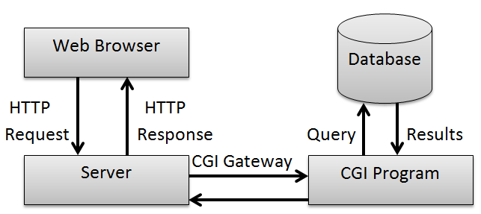
Understanding Common Gateway Interface

Slide 4
Advantages
language independent, can be written in any programming languages.
It is simple.
It is lightweight and Speedy since You don’t need to have any specific particular library to make a CGI program.

Slide 5
Disadvantages
Response time is high.
The creation of an OS Shell is an heavy weight activity.
CGI is not scalable.
Not always secure or object-oriented.
No separation of presentation and business logic.
Scripting languages are often platform-dependent.

Slide 6
Advantage of servlets over CGI
CGI and servlets are used to develop web application only.
CGI is a oldest technique.
The main drawback of CGI is
1. starting process is very expensive
2. it performs very poor.

Slide 7
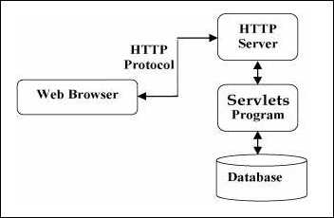
Servlets Architecture

Slide 8
Advantage of servlets over CGI
Performance
Portability,
Error handling,
Session management, and
Access to and ability to extend the server itself.

Slide 9
Platform Independence
Servlets are written entirely in java so these are platform independent.
Servlets can run on any Servlet enabled web server.
For example: if you develop an web application in windows machine running Java web server, you can easily run the same on apache web server (if Apache Serve is installed) without modification or compilation of code.

Slide 10
Performance
Due to interpreted nature of java, programs written in java are slow.
The java servlets runs very fast.
Servlets run on web server.
For any program initialization takes significant amount of time. But in case of servlets initialization takes place first time it receives a request and remains in memory till times out or server shut downs. After servlet is loaded, to handle a new request it simply creates a new thread and runs service method of servlet.

Slide 11
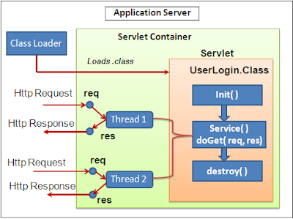
Life Cycle Of Servlet

Slide 12
Extensibility
Java Servlets are developed in java which is robust, well-designed and object oriented language which can be extended into new objects.
The java servlets take all these advantages and can be extended from existing class to provide the ideal solutions.

Slide 13
Safety
Java provides very good safety features like memory management, exception handling etc. Servlets inherits all these features and emerged as a very powerful web server extension.

Slide 14
Secure
Servlets are server side components, so it inherits the security provided by the web server. Servlets are also benefited with Java Security Manager.

Slide 15
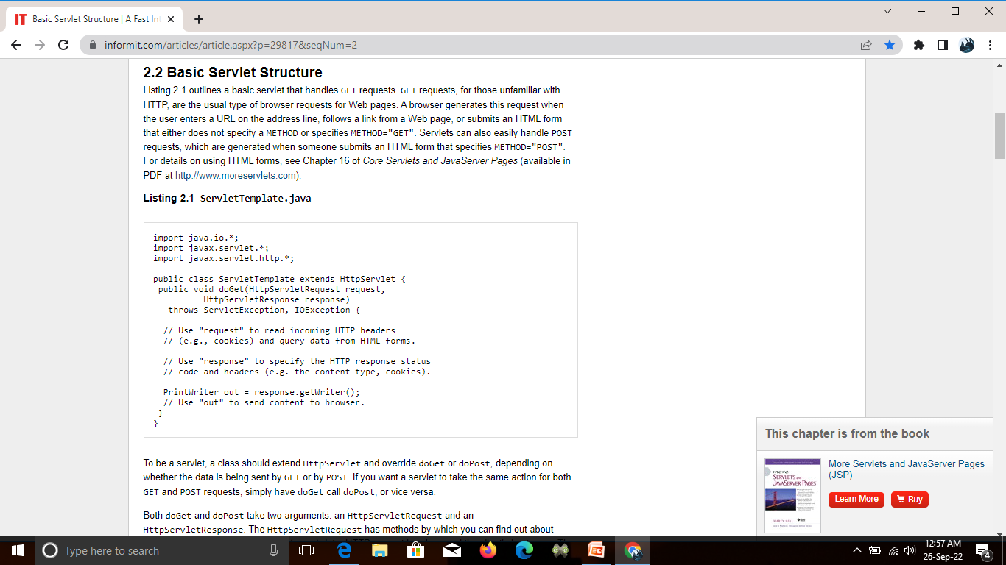
Basic servlet structure

Slide 16
Servlet Packaging
When you use packages, you need to perform the following two additional steps.
Move the files to a subdirectory that matches the intended package name. For example, I'll use the more servlets package for most of the rest of the servlets in this book. So, the class files need to go in a subdirectory called more servlets.
Insert a package statement in the class file: For example, to place a class in a package called somePackage, the class should be in the somePackage directory and the first non-comment line of the file should read package somePackage;

Slide 17
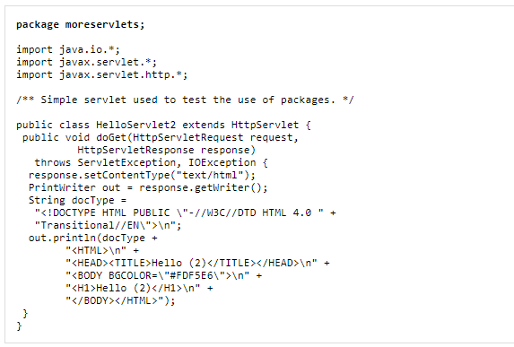
Servlet Packaging

Slide 18
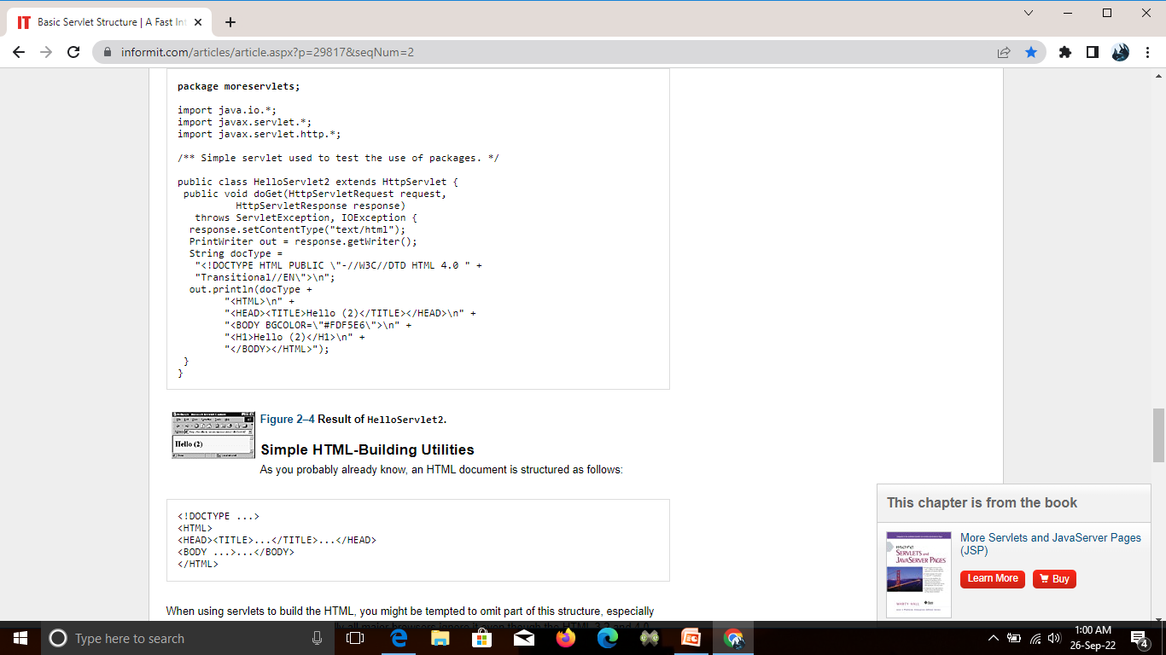
HTML- Building utilities

Slide 19
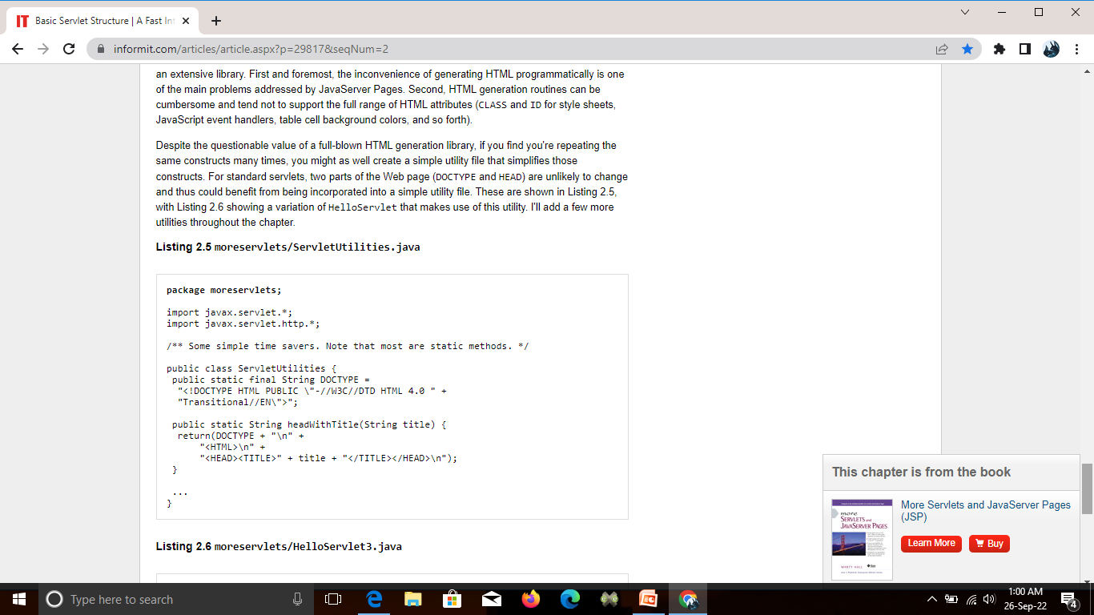
Servlet utilities

Slide 20
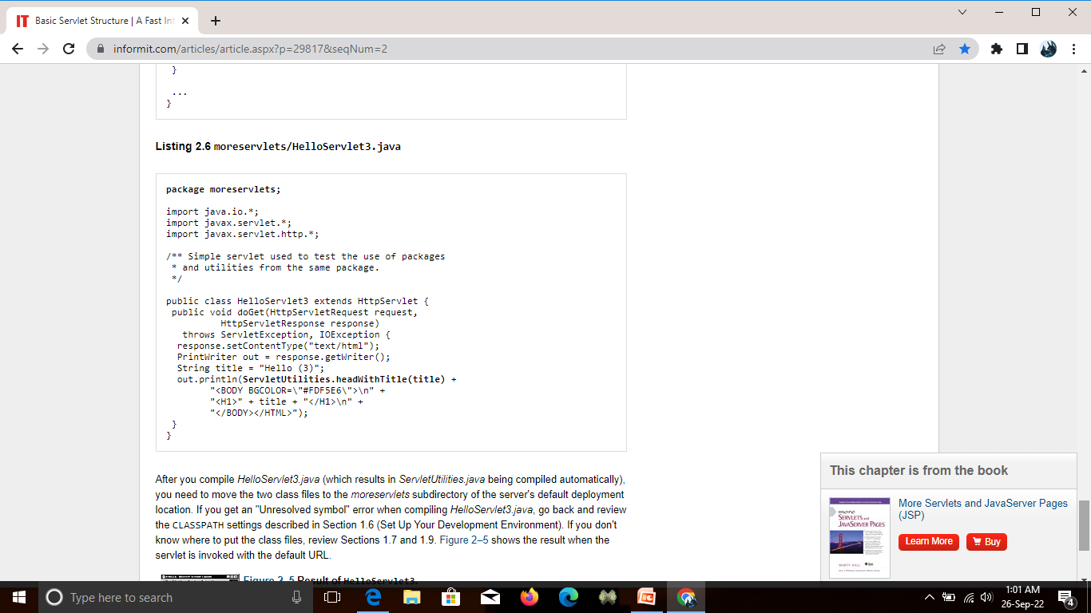

Slide 21
Life cycle of servlet

Slide 22
Single Thread Model Interface
Single Thread Model Interface was designed to guarantee that only one thread is executed at a time in a given servlet instance service method.
It should be implemented to ensure that the servlet can handle only one request at a time.
Once the interface is implemented the system guarantees that there’s never more than one request thread accessing a single instance servlet.
Syntax: public class Myservlet extends Httpservlet implements SingleThreadModel
{
}

Slide 23
Handling the Client Request: FORM DATA
HTML forms, gives details on how to build forms that collect and transmit data of this sort.
1. Use the FORM element to create an HTML form.
<FORM ACTION="...">...</FORM>
2. Use input elements to collect user data
<INPUT TYPE="TEXT" NAME="...">
3. Place a submit button near the bottom of the form. For example: <INPUT TYPE="SUBMIT">

Slide 24
Handling the Client Request: FORM DATA
When the button is pressed, the URL designated by the form’s ACTION is invoked. With GET requests, a question mark and name/ value pairs are attached to the end of the URL, where the names come from the NAME attributes in the HTML input elements and the values come from the end user. With POST requests, the same data is sent, but on a separate request line instead of attached to the URL.

Slide 25
Reading Form Data from Servlets
Reading Single Values: getParameter
To read a request (form) parameter, you simply call the getParameter method of HttpServletRequest, supplying the case-sensitive parameter name as an argument.
You supply the parameter name exactly as it appeared in the HTML source code, and you get the result exactly as the end user entered it; any necessary URL-decoding is done automatically.

Slide 26
Reading Multiple Values: getParameterValues
If the same parameter name might appear in the form data more than once, you should call getParameterValues (which returns an array of strings) instead of getParameter.
The return value of getParameterValues is null for nonexistent parameter names and is a one-element array when the parameter has only a single value.

Slide 27
Looking Up Parameter Names: getParameterNames and getParameterMap
Use getParameterNames to get list in the form of an Enumeration, each entry of which can be cast to a String and used in a getParameter or getParameterValues call.
If there are no parameters in the current request, getParameterNames returns an empty Enumeration (not null).
An alternative to getParameterNames is getParameterMap. This method returns a Map: the parameter names (strings) are the table keys and the parameter values (string arrays as returned by getParameterNames) are the table values.

Slide 28
Reading Raw Form Data and Parsing Uploaded Files: getReader or getInputStream
Rather than reading individual form parameters, you can access the query data directly by calling getReader or getInputStream on the HttpServletRequest and then using that stream to parse the raw input.
Note: however, that if you read the data in this manner, it is not guaranteed to be available with getParameter.

Slide 29
Reading the raw input is of use in two situations
The first case in which you might read and parse the data yourself is when the data comes from a custom client rather than by an HTML form.
The second situation in which you might read the data yourself is when the data is from an uploaded file. HTML supports a FORM element (<INPUT TYPE="FILE"...>) that lets the client upload a file to the server.

Slide 30
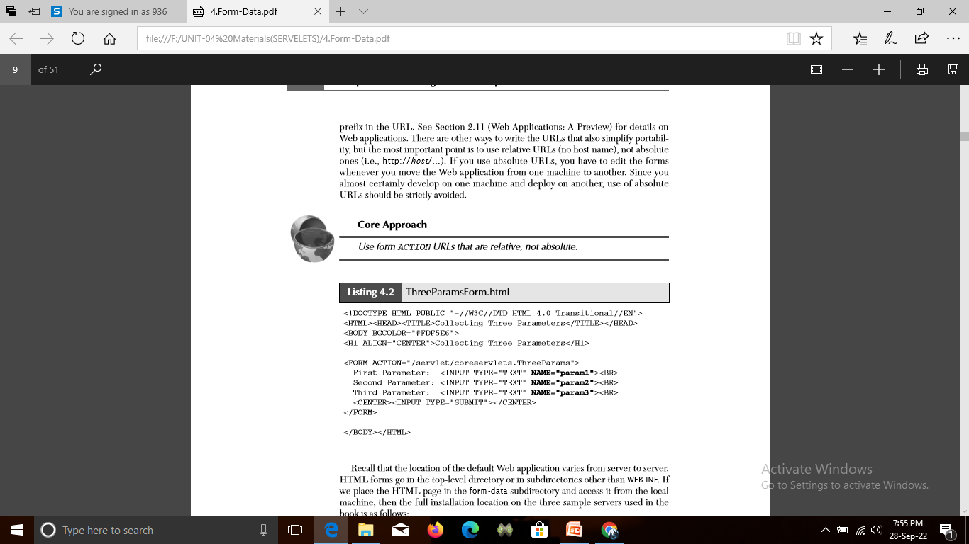
Reading Three Parameters

Slide 31
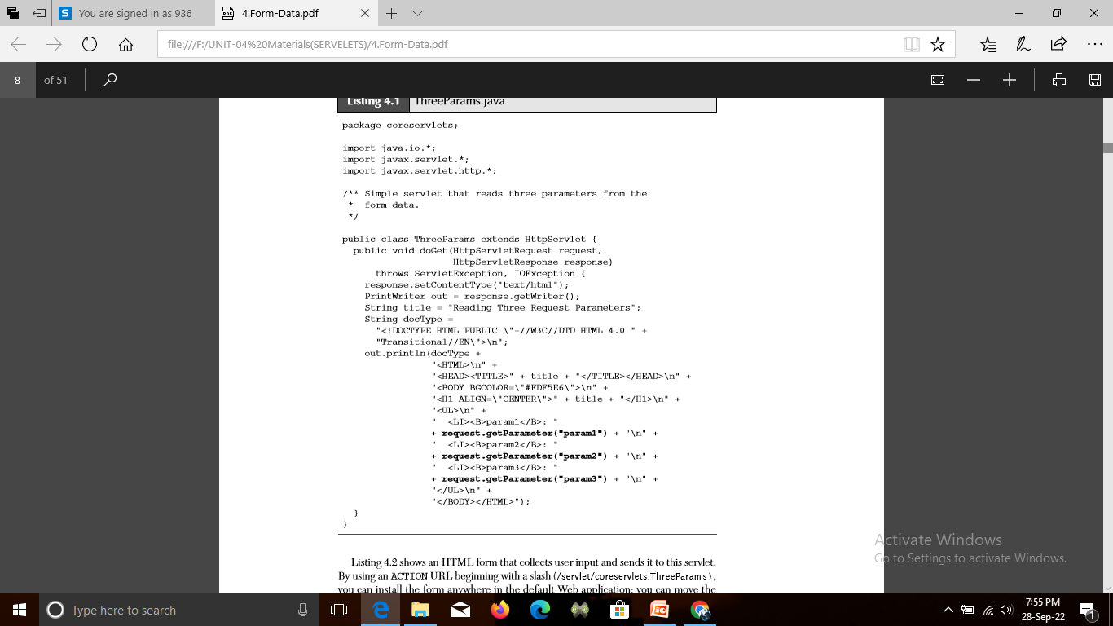

Slide 32
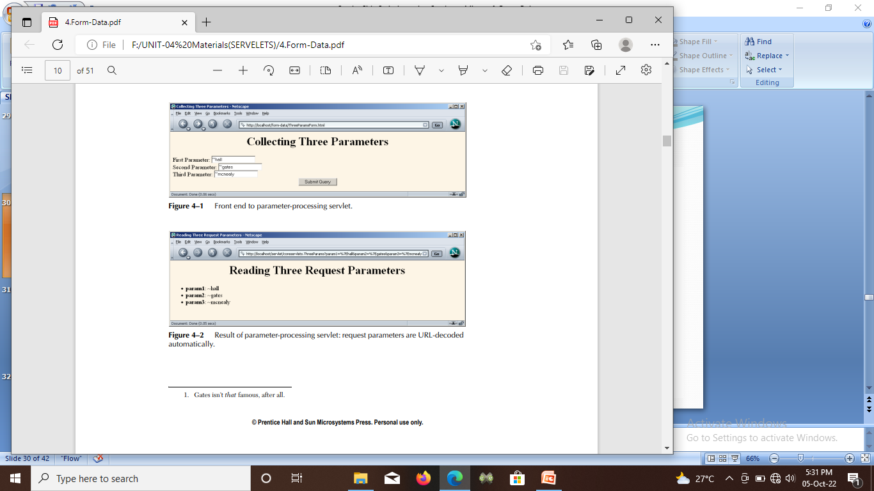
Reading Three Parameters

Slide 33
Reading Three Parameters
HTML form that collects user input and sends it to this servlet. By using an ACTION URL beginning with a slash (/servlet/coreservlets.ThreeParams), you can install the form anywhere in the default Web application.
you can move the HTML form to another directory or move both the HTML form and the servlet to another machine, all without editing the HTML form or the servlet.
The general principle that form URLs beginning with slashes increases portability holds true even when you use custom Web applications, but you have to include the Web application prefix in the URL.

Slide 34
Example: Reading All Parameters
First, the servlet looks up all the parameter names with the getParameterNames method of HttpServletRequest.
This method returns an Enumeration that contains the parameter names in an unspecified order.
Next, the servlet loops down the Enumeration in the standard manner, using hasMoreElements to determine when to stop and using nextElement to get each parameter name.

Slide 35
Example: Reading All Parameters
nextElement returns an Object, the servlet casts the result to a String and passes that to getParameterValues, yielding an array of strings.
If that array is one entry long and contains only an empty string, then the parameter had no values and the servlet generates an italicized “No Value” entry.
If the array is more than one entry long, then the parameter had multiple values and the values are displayed in a bulleted list. Otherwise, the single value is placed directly into the table.

Slide 36
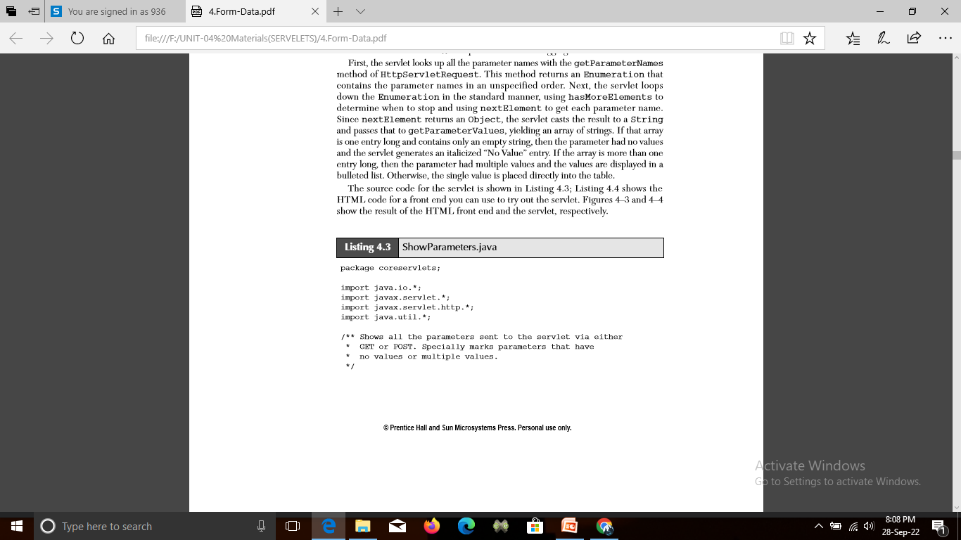
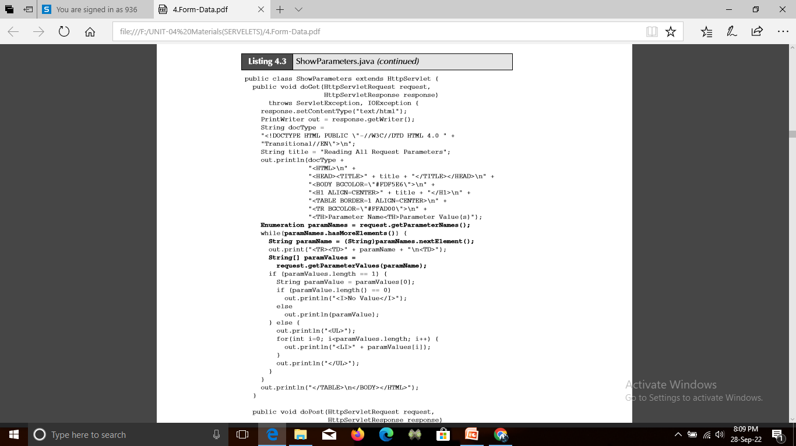

Slide 37
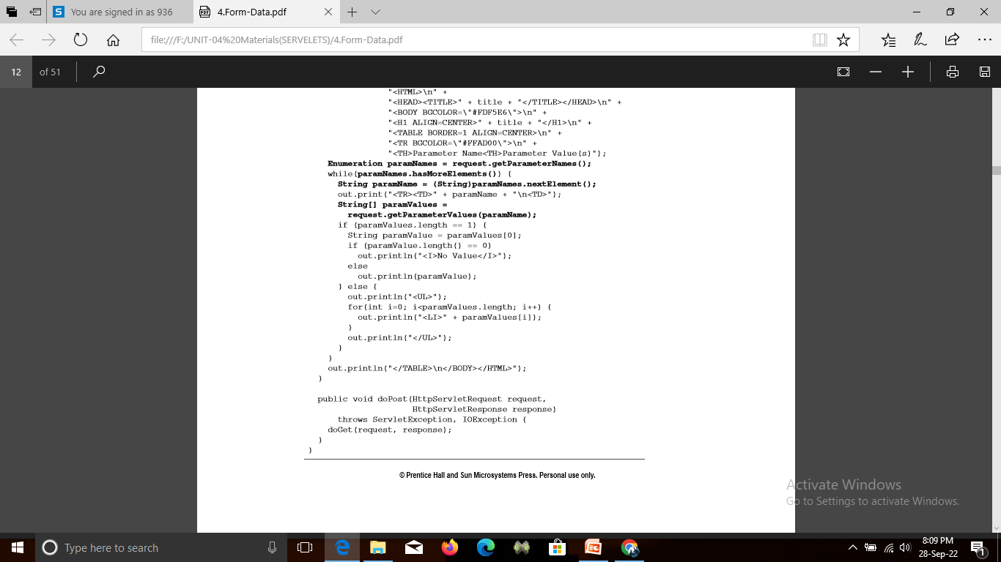

Slide 38
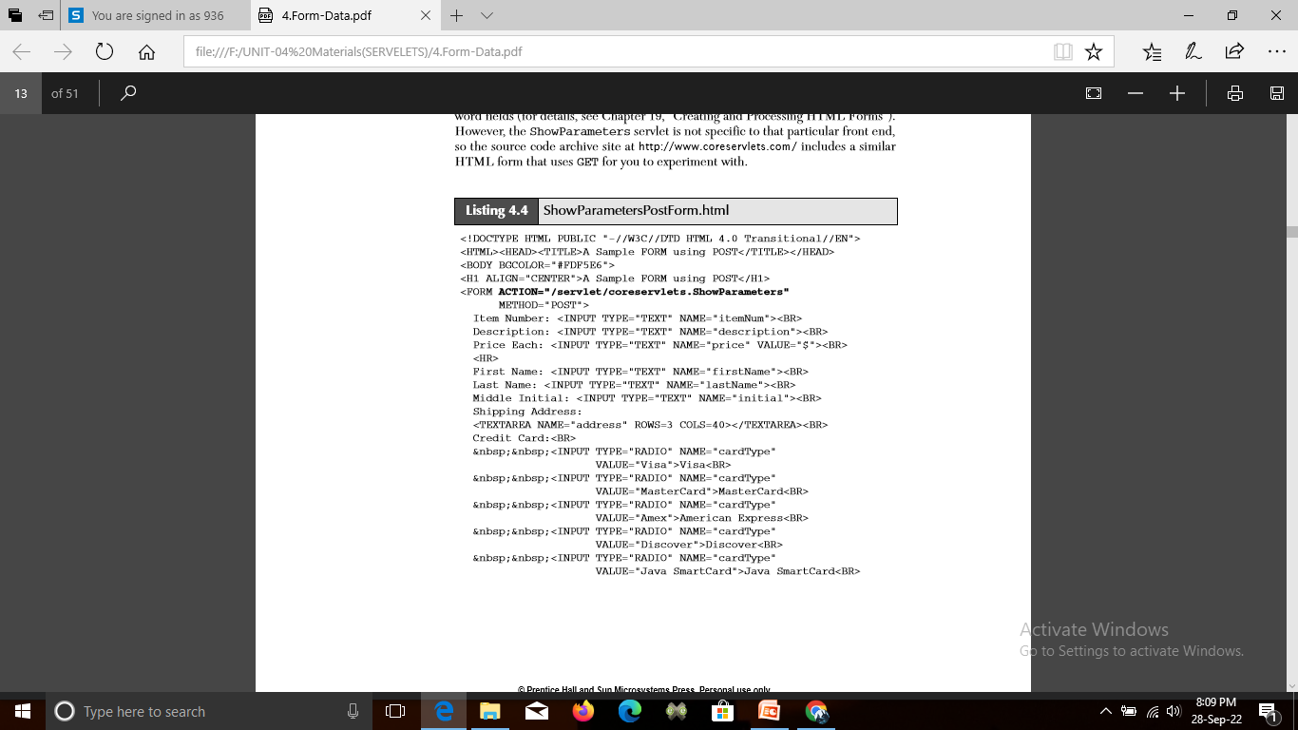
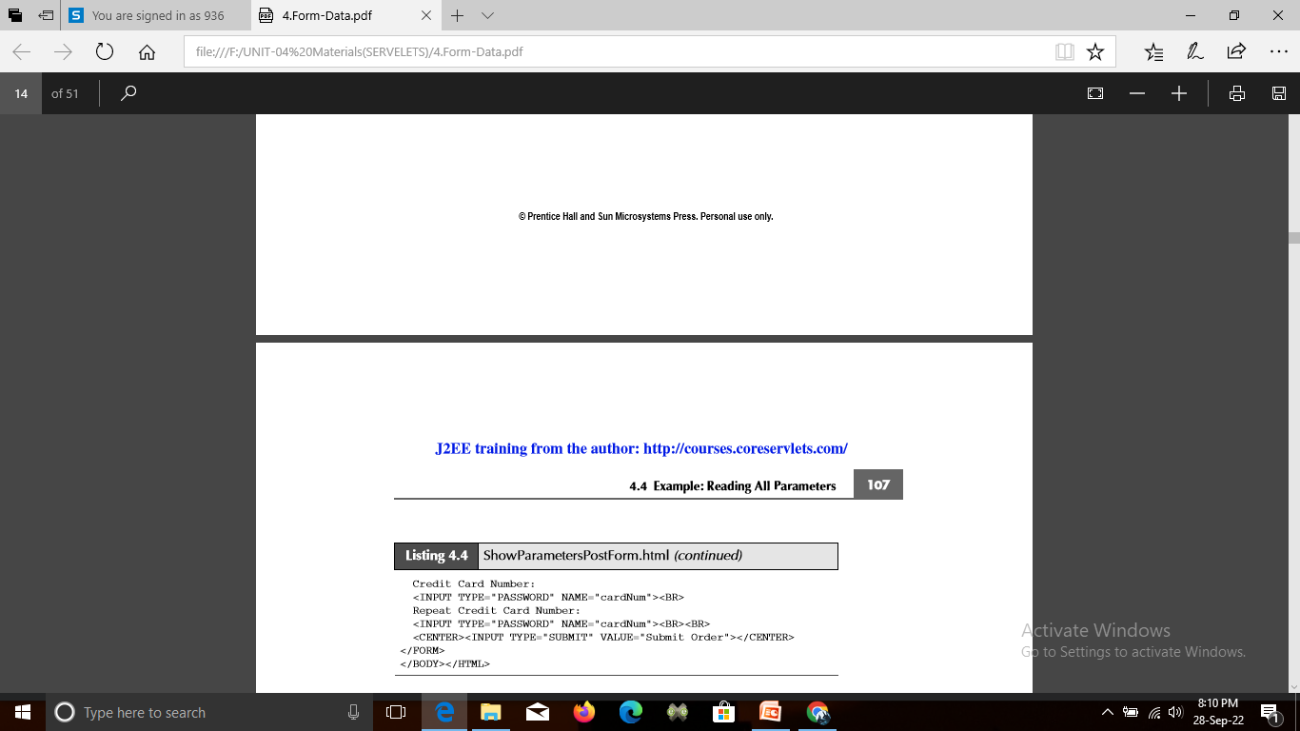

Slide 39
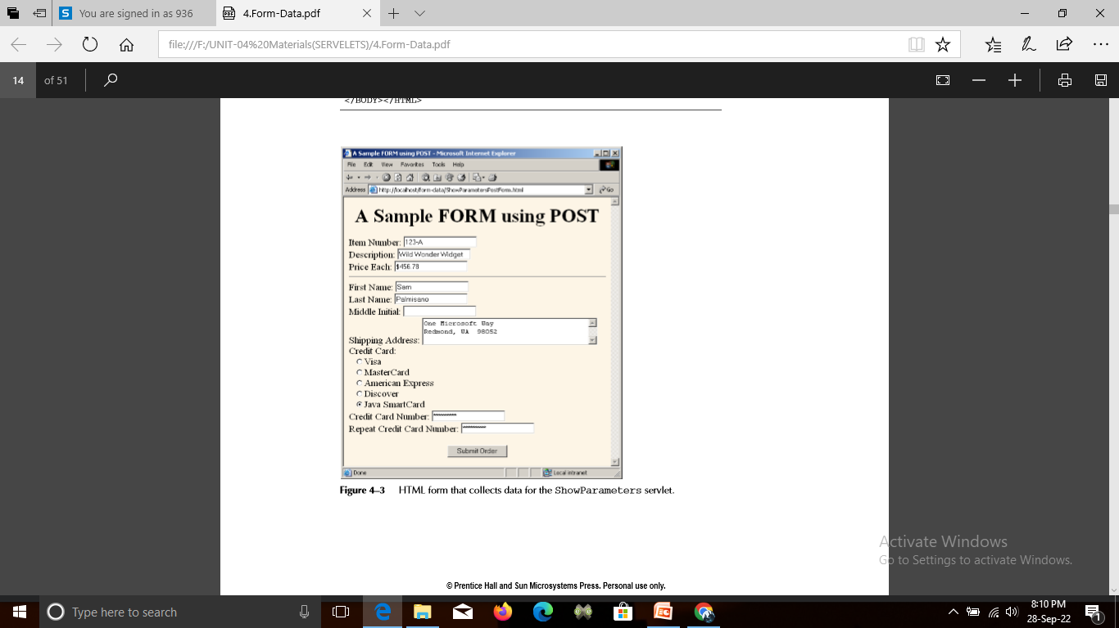
Output

Slide 40
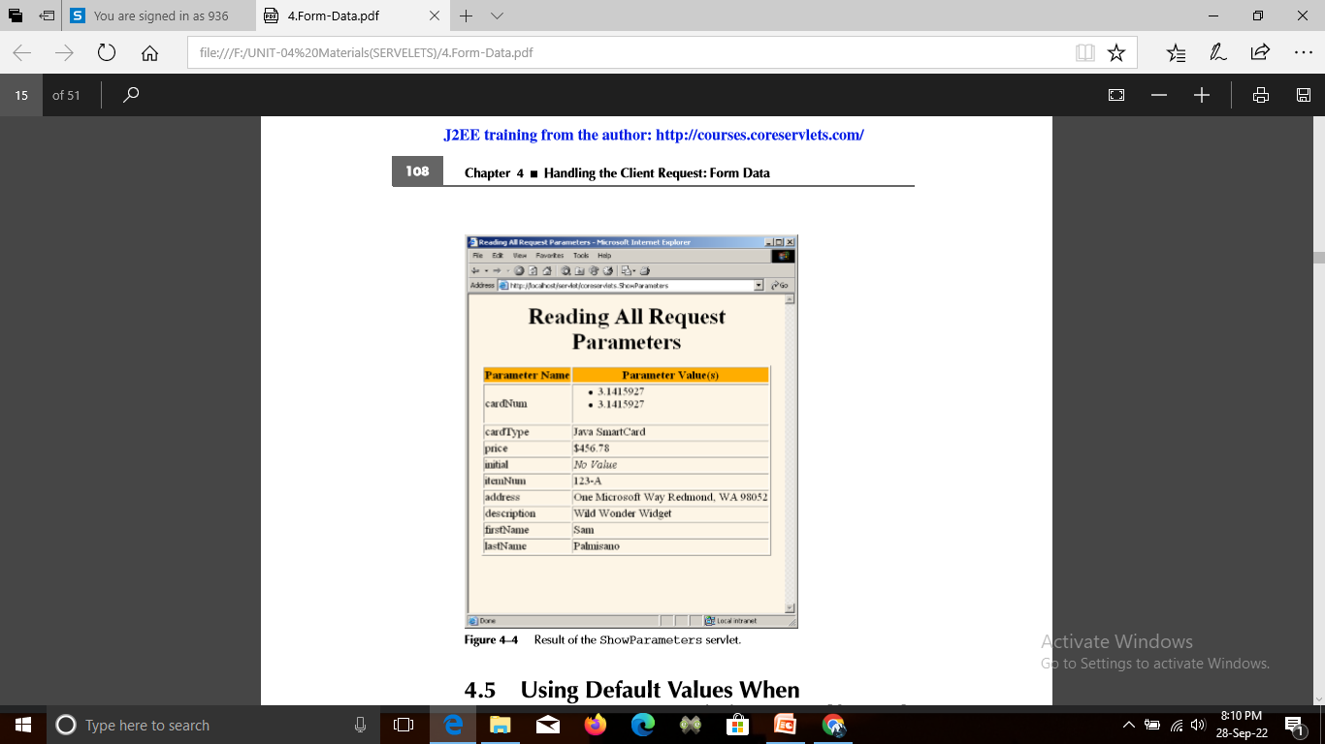
Output

Slide 41
Using Default Values When Parameters Are Missing or Malformed
When examining request parameters, you need to check for three conditions:
The value is null: A call to request.getParameter returns null if the form contains no textfield or other element of the expected name so that the parameter name does not appear in the requlest at all.
The value is an empty string: A call to request.getParameter returns an empty string (i.e., "") if the associated textfield is empty when the form is submitted. To check for an empty string, compare the string to "" by using equals or compare the length of the string to 0.

Slide 42
Using Default Values When Parameters Are Missing or Malformed
String param = request.getParameter("someName");
if ((param == null) || (param.trim().equals(""))) { doSomethingForMissingValues(...); } else { doSomethingWithParameter(param); }
The value is a nonempty string of the wrong format: What defines the wrong format is application specific: you might expect certain textfields to contain only numeric values, others to have exactly seven characters, and others to only contain single letters.

Slide 43
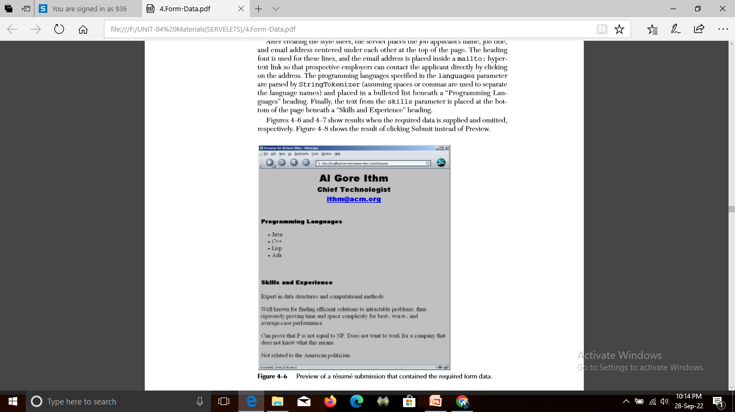
Using Default Values When Parameters Are Missing or Malformed

Slide 44
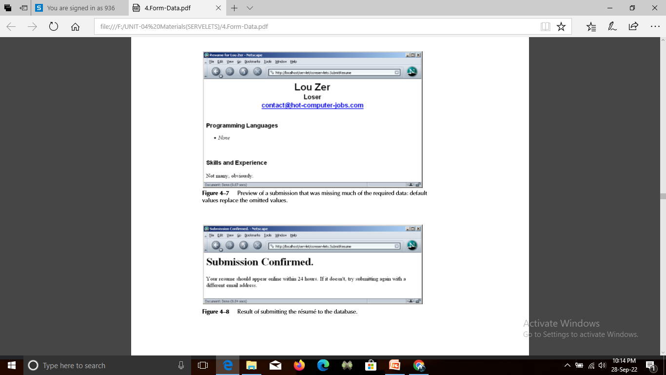
Using Default Values When Parameters Are Missing or Malformed

Slide 45
Filtering Strings for HTML-Specific Characters
Normally, when a servlet wants to generate HTML that will contain characters like < or >, it simply uses < or >, the standard HTML character entities. Similarly, if a servlet wants a double quote or an ampersand to appear inside an HTML attribute value, it uses " or &. Failing to make these substitutions results in malformed HTML code.
In most cases, it is easy to note the special characters and use the standard HTML replacements. However, there are two cases in which it is not so easy to make this substitution manually.

Slide 46
Filtering Strings for HTML-Specific Characters
The first case in which manual conversion is difficult occurs when the string is derived from a program excerpt or another source in which it is already in some standard format. Going through manually and changing all the special characters can be tedious in such a case, but forgetting to convert even one special character can result in your Web page having missing or improperly formatted sections.

Slide 47
Filtering Strings for HTML-Specific Characters
The second case in which manual conversion fails is when the string is derived from HTML form data. Here, the conversion absolutely must be performed at run time, since of course the query data is not known at compile time. If the user accidentally or deliberately enters HTML tags, the generated Web page will contain spurious HTML tags and can have completely unpredictable results.

Slide 48
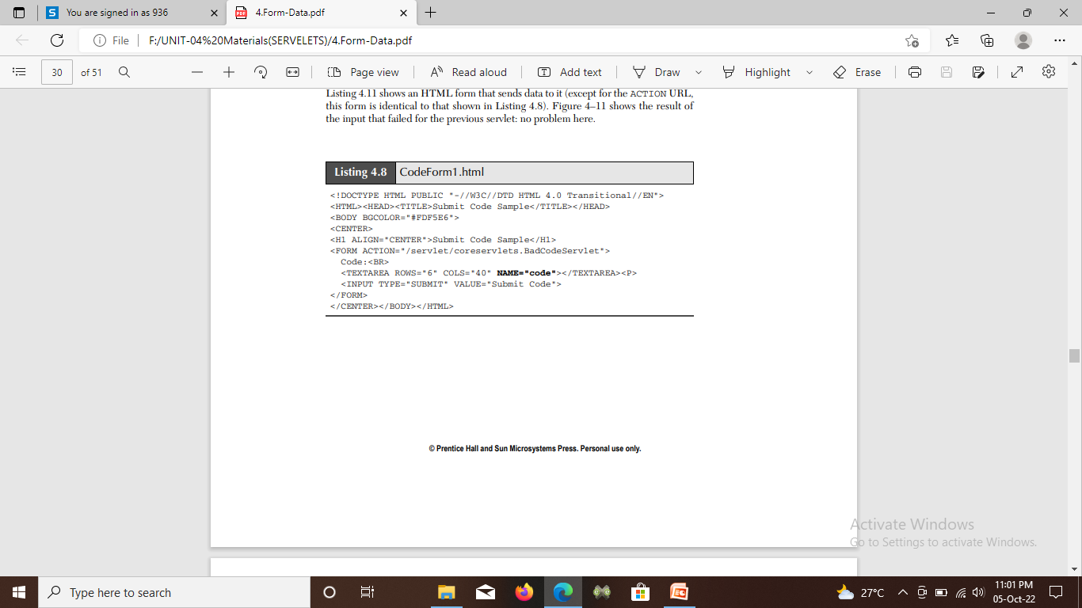
Example: A Servlet That Displays Code Snippets

Slide 49
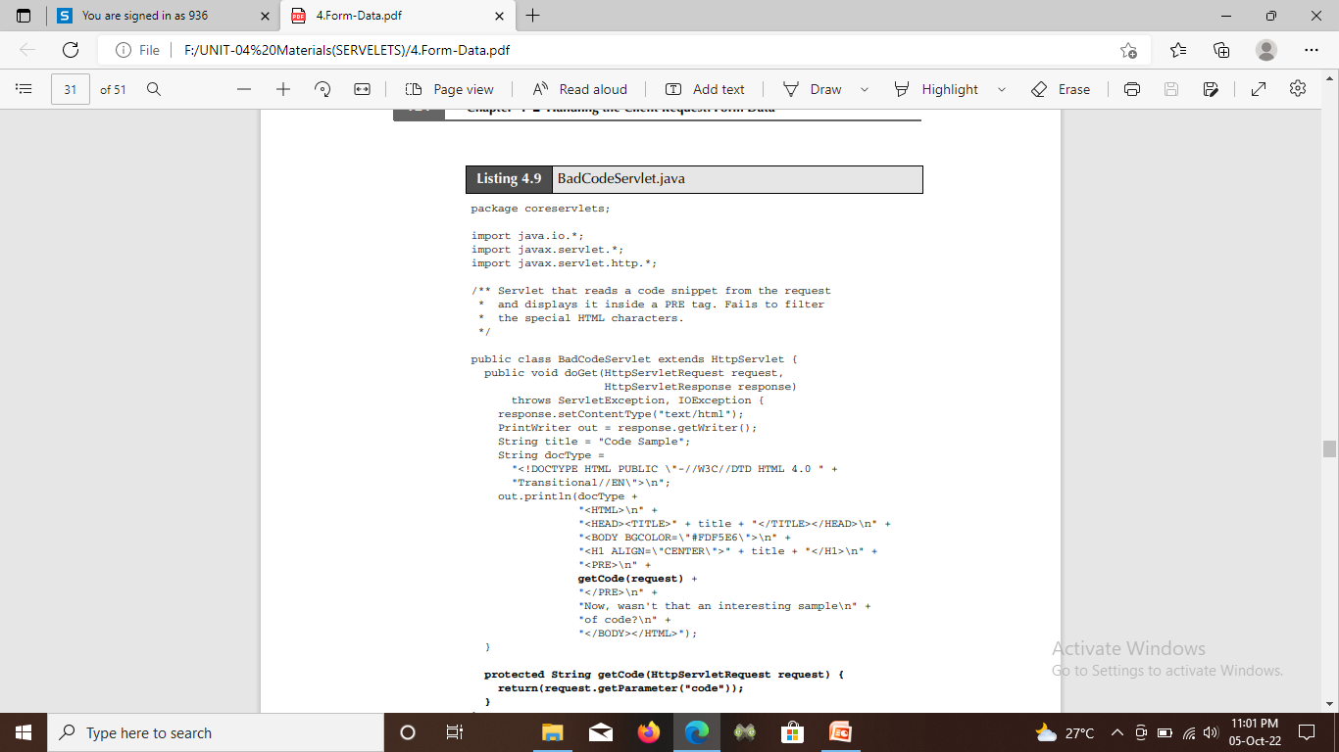

Slide 50
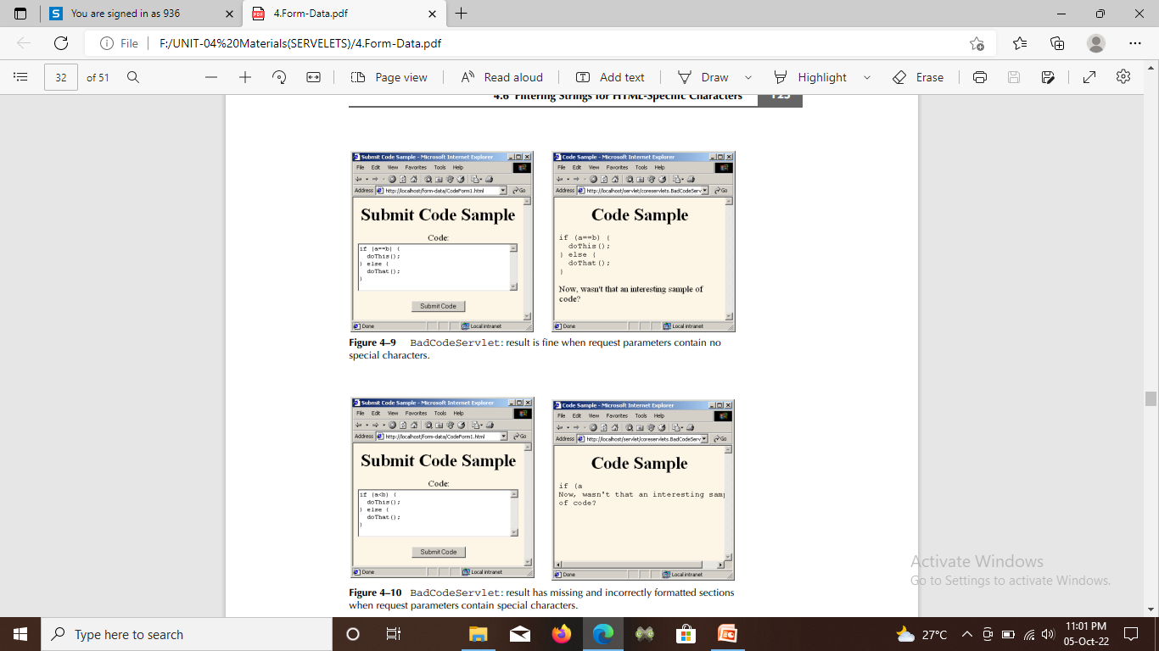

Slide 51
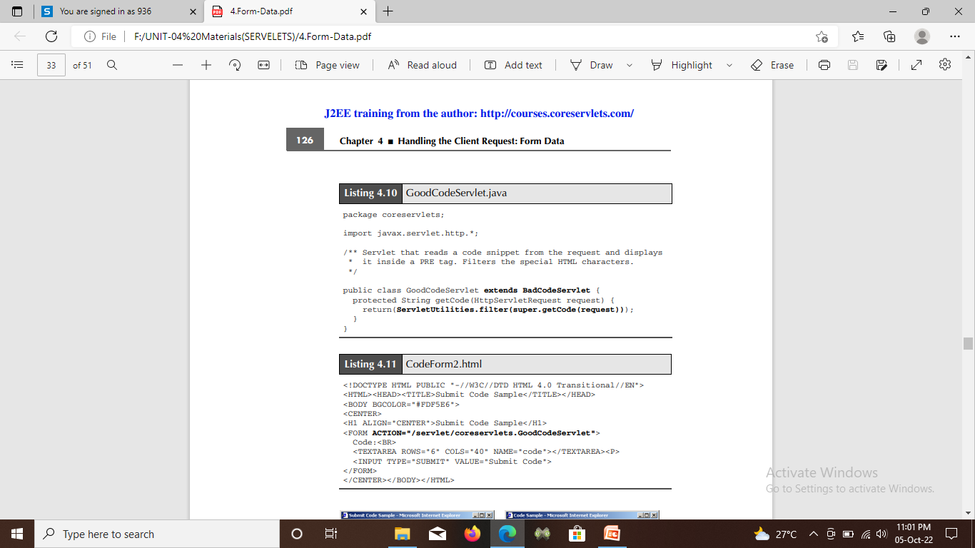

Slide 52
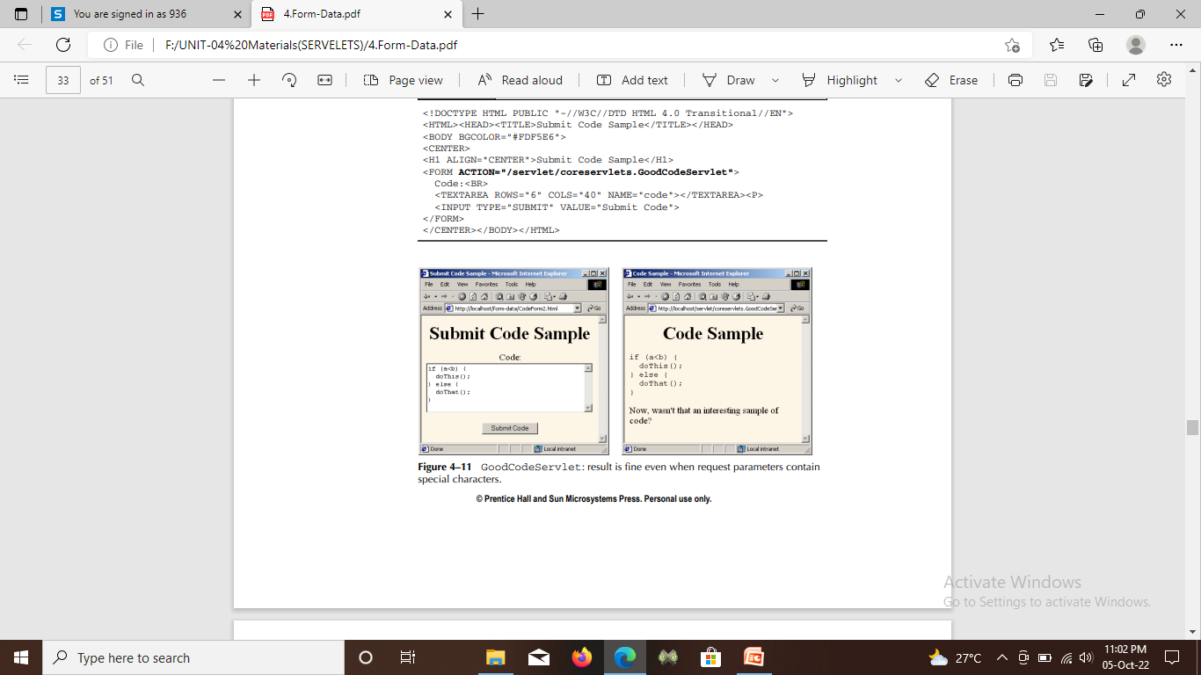

Slide 53
Automatically Populating Java Objects from Request Parameters: Form Beans
The getParameter method makes it easy to read incoming request parameters, and the value returned is automatically URL-decoded.
The return value of getParameter is String, however, you have to parse the value yourself if you want other types of values.

Slide 54
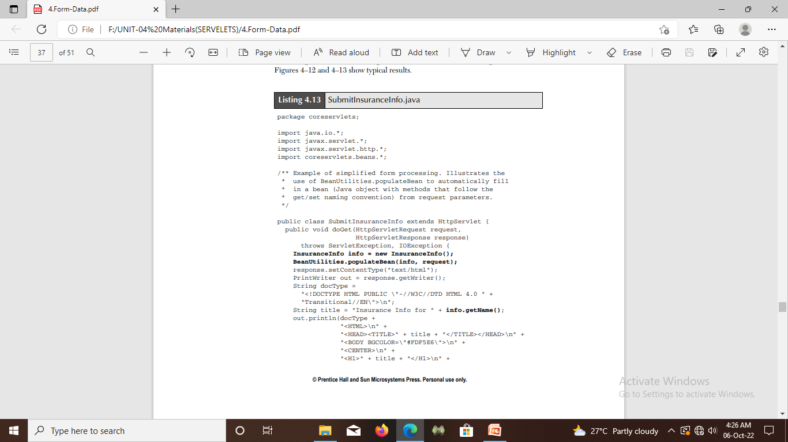
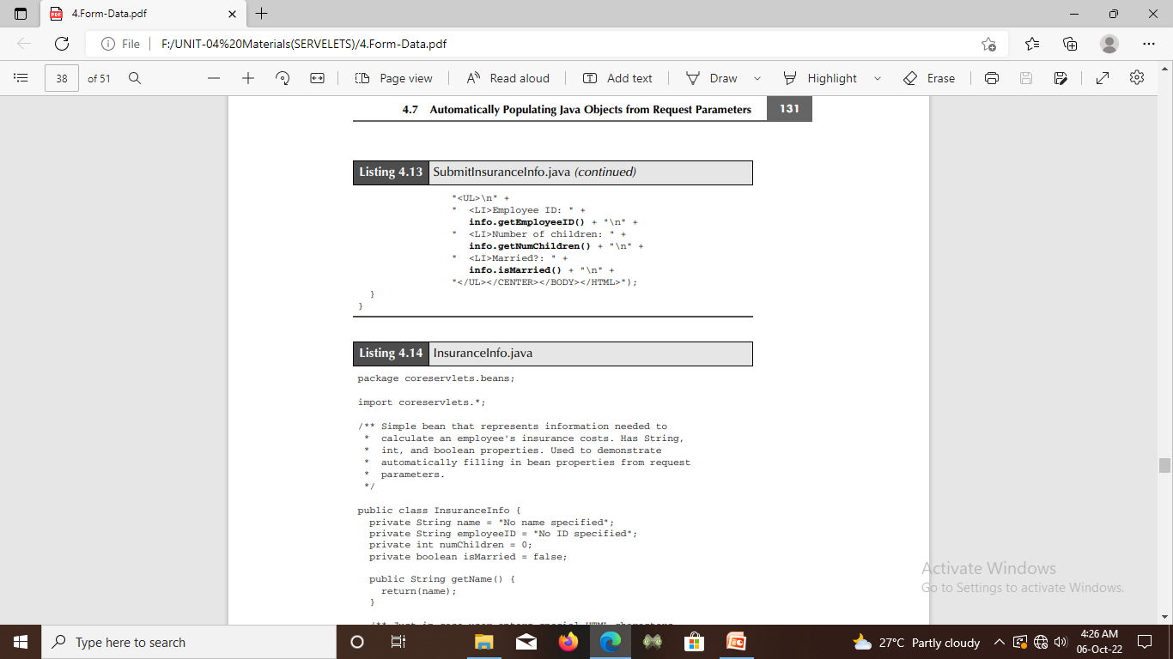
Putting Bean Utilities to Work

Slide 55
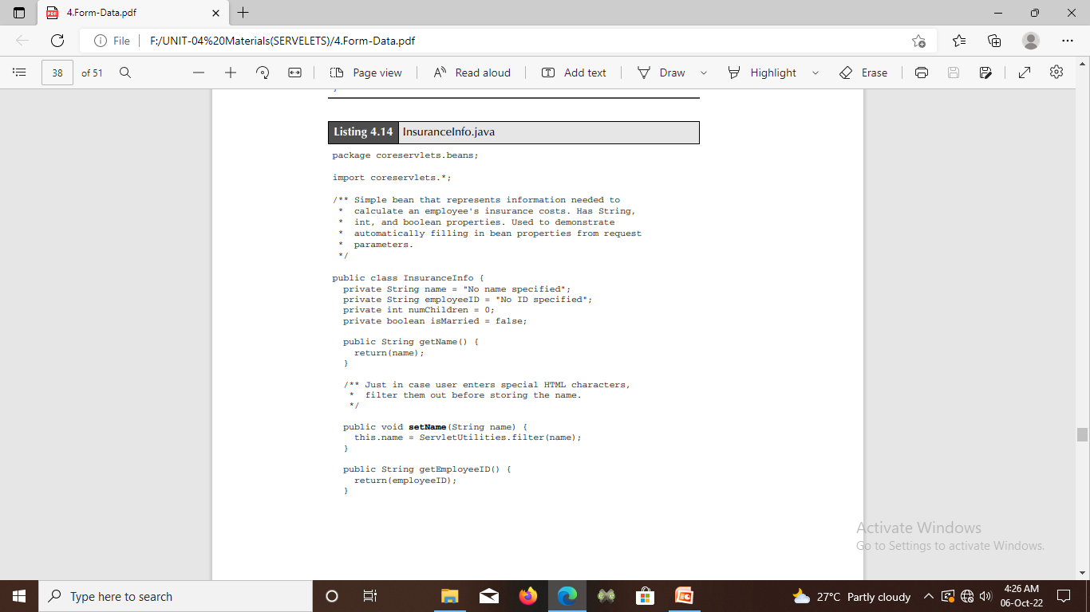
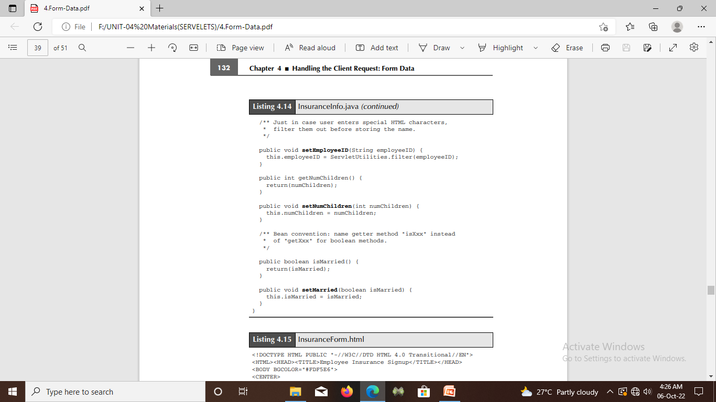

Slide 56
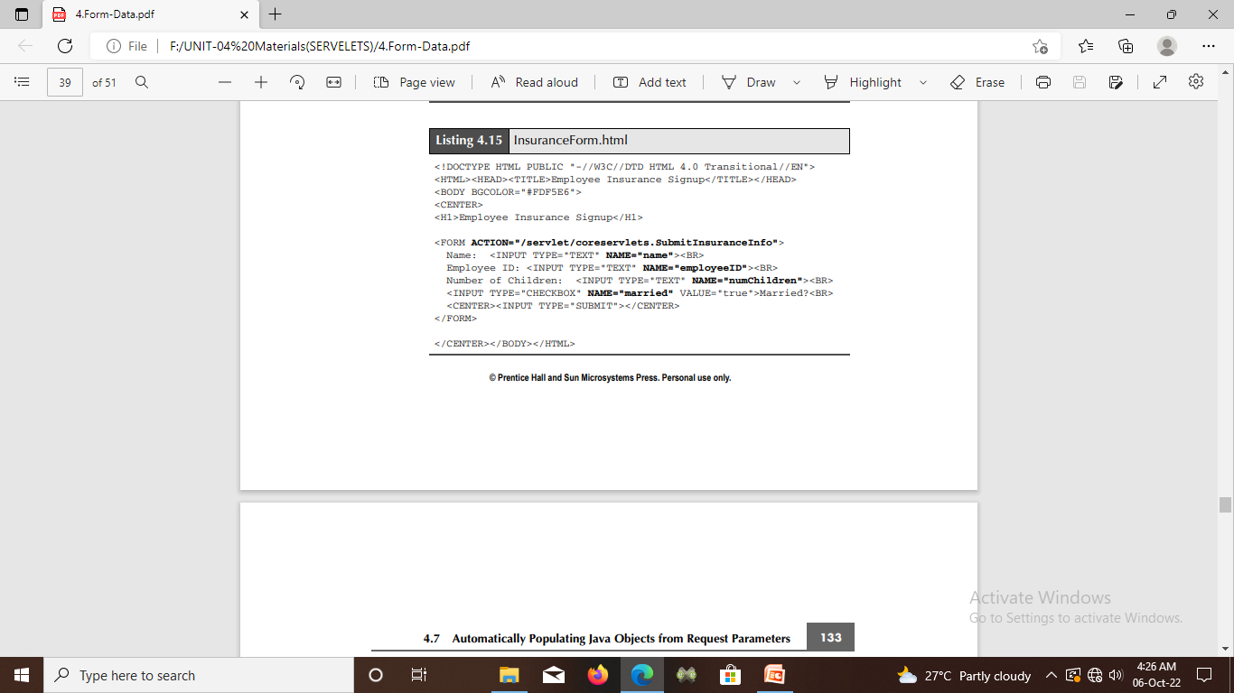

Slide 57
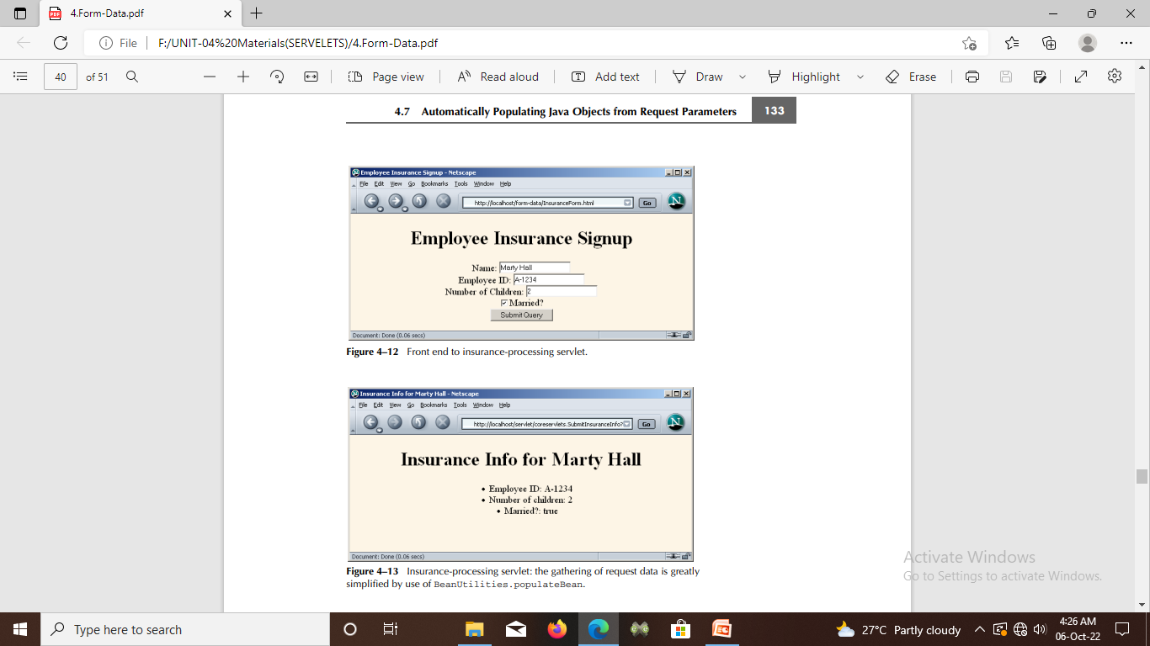

Slide 58
Obtaining and Installing the Jakarta Commons Packages
Most of the work of our Bean Utilities class is done by the Jakarta Commons BeanUtils component.
This component performs the reflection and the type conversion .
Bean Utilities will not work unless you install the Jakarta Commons BeanUtils. However, since BeanUtils depends on two other Jakarta Commons components—Collections and Logging—you have to download and install all three.

Slide 59
Redisplaying the Input Form When Parameters Are Missing or Malformed
It sometimes makes sense to use default values when the user fails to fill in certain form fields.
however, there are no reasonable default values to use, and the form should be redisplayed to the user.
Two desirable capabilities make the use of a normal HTML form impossible in this scenario:
• Users should not have to reenter values that they already supplied.
• Missing form fields should be marked prominently.

Slide 60
Redisplay Options
1. Have the same servlet present the form, process the data, and present the results: The servlet first looks for incoming request data, if it finds none, it presents a blank form. If the servlet finds partial request data, it extracts the partial data, puts it back into the form, and marks the other fields as missing. If the servlet finds the full complement of required data, it processes the request and displays the results

Slide 61
2. Have one servlet present the form; have a second servlet process the data and present the results:
It divides up the labor and keeps each servlet smaller and more manageable.
Transferring from one servlet to another can be done with response.sendRedirect or the forward method of RequestDispatcher.

Slide 62
3. Have a JSP page “manually” present the form; have a servlet or JSP page process the data and present the results:
However, it requires knowledge of JSP in addition to knowledge of the two techniques mentioned in the previous point.
In particular, use JSP expressions or jsp:getProperty to extract the partial data from the data object and put it into the HTML form.

Slide 63
4. Have a JSP page present the form, automatically filling in the fields with values obtained from a data object. Have a servlet or JSP page process the data and present the results.
It requires custom JSP tags that mimic HTML form elements but use designated values automatically.
You can write these tags yourself or you can use ready-made versions such as those that come with JSTL or Apache Struts.

Slide 64
HANDLING THE CLIENT REQUEST: HTTP REQUEST HEADERS
HTTP request headers are distinct from the form (query) data.
Form data results directly from user input and is sent as part of the URL for GET requests and on a separate line for POST requests.
Request headers are indirectly set by the browser and are sent immediately following the initial GET or POST request line.
For instance, the following example shows an HTTP request that might result from a user submitting a book-search request to a servlet at http://www.somebookstore.com/servlet/Search.
The request includes the headers Accept, Accept-Encoding, Connection, Cookie, Host, Referrer, and User-Agent

Slide 65
Reading Request Headers
Reading headers is straightforward.
Just call the getHeader method of HttpServletRequest with the name of the header. This call returns a String if the specified header was supplied in the current request, null otherwise.
In HTTP 1.0, all request headers are optional.
in HTTP 1.1, only Host is required. So, always check for null before using a request header

Slide 66
Header names are not case sensitive. So, for example, request.getHeader("Connection") is interchangeable with request.getHeader("connection").
A few headers are so commonly used that they have special access methods in HttpServletRequest.
1. getCookies : The getCookies method returns the contents of the Cookie header, parsed and stored in an array of Cookie objects.
2. getAuthType and getRemoteUser: The getAuthType and getRemoteUser methods break the Authorization header into its component pieces.

Slide 67
3. getContentLength: The getContentLength method returns the value of the Content-Length header (as an int).
getContentType: The getContentType method returns the value of the Content-Type header (as a String).
getDateHeader and getIntHeader: The getDateHeader and getIntHeader methods read the specified headers and then convert them to Date and int values, respectively.
getHeaderNames: Rather than looking up one particular header, you can use the getHeaderNames method to get an Enumeration of all header names received on this particular request

Slide 68
7. getHeaders: In most cases, each header name appears only once in the request. Occasionally, however, a header can appear multiple times, with each occurrence listing a separate value. Accept-Language is one such example. You can use getHeaders to obtain an Enumeration of the values of all occurrences of the header.
8. getMethod: The getMethod method returns the main request method (normally, GET or POST, but methods like HEAD, PUT, and DELETE are possible).
9. getRequestURI: The getRequestURI method returns the part of the URL that comes after the host and port but before the form data. For example, for a URL of http://randomhost.com/servlet/search.BookSearch?subject=jsp, getRequestURI would return "/servlet/search.BookSearch“.

Slide 69
10. getQueryString : The getQueryString method returns the form data. For example, with http://randomhost.com/servlet/search.BookSearch?subject=jsp, getQueryString would return "subject=jsp".

Slide 70
Making a Table of All Request Headers
A servlet that simply creates a table of all the headers it receives, along with their associated values.
It accomplishes this task by calling request.getHeaderNames to obtain an Enumeration of headers in the current request.
It then loops down the Enumeration, puts the header name in the left table cell, and puts the result of getHeader in the right table cell.

Slide 71
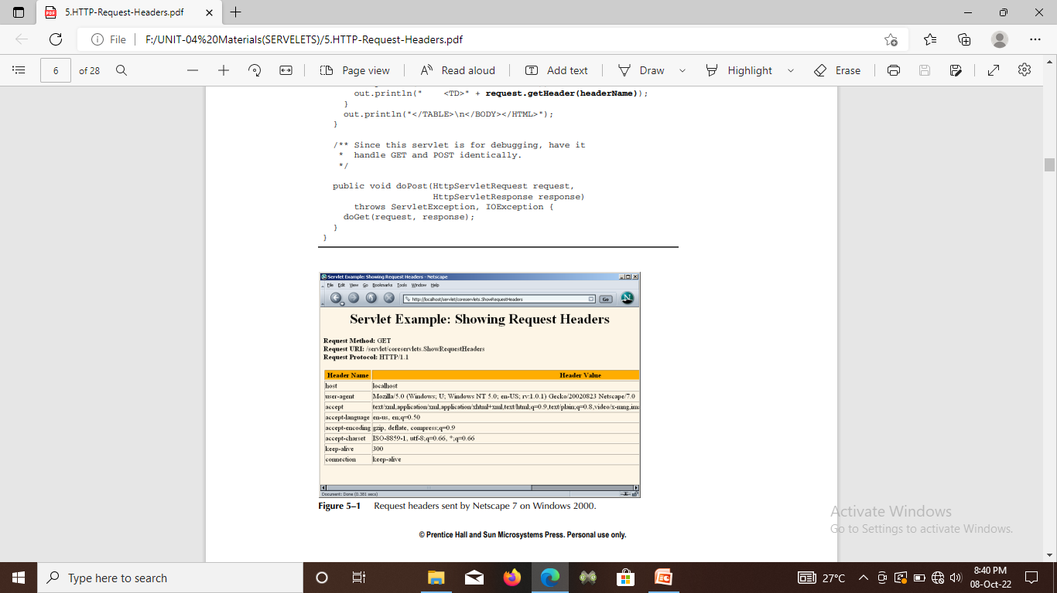
The servlet also prints three components of the main request line (method, URI, and protocol).

Slide 72
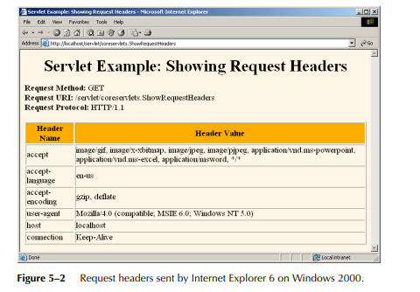

Slide 73
Understanding HTTP 1.1 Request Headers
Accept :
A servlet that can return a resource in more than one format can examine the Accept header to decide which format to use.
For example, images in PNG format have some compression advantages over those in GIF, but not all browsers support PNG. If you have images in both formats, your servlet can call request.getHeader("Accept"), check for image/png, and if it finds a match, use blah.png filenames in all the IMG elements it generates. Otherwise, it would just use blah.gif.

Slide 74
Accept-Language: This header specifies the client’s preferred languages in case the servlet can produce results in more than one language. The value of the header should be one of the standard language codes such as en, en-us, da, etc.
Authorization: This header is used by clients to identify themselves when accessing password-protected Web pages.
Connection: Persistent connections permit the client or other browser to retrieve multiple files with a single socket connection, thus saving the overhead of negotiating several independent connections

Slide 75
Content-Length :This header is applicable only to POST requests and gives the size of the POST data in bytes. Rather than calling request.getIntHeader("Content-Length"), you can simply use request.getContentLength().
Cookie: This header returns cookies to servers that previously sent them to the browser. Never read this header directly because doing so would require cumbersome low-level parsing; use request.getCookies instead.
Host: In HTTP 1.1 browsers and other clients are required to specify this header, which indicates the host and port as given in the original URL.

Slide 76
Sending Compressed Web Pages
Gzip is a text compression scheme that can dramatically reduce the size of HTML (or plain text) pages.
Most recent browsers know how to handle gzipped content, so the server can compress the document and send the smaller document over the network, after which the browser will automatically reverse the compression (no user action required) and treat the result in the normal manner. Sending such compressed content can be a real time saver.

Slide 77
Differentiating Among Different Browser Types
The User-Agent header identifies the specific browser that is making the request. Although use of this header appears straightforward at first glance, a few subtleties are involved:
Use User-Agent only when neccessary: Otherwise, you will have difficult-to-maintain code that consists of tables of browser versions and associated capabilities.
Check for null: You should always check that the result of request.getHeader is non-null before trying to use it, regardless of which header you are dealing with.

Slide 78
3. To differentiate between Netscape and Internet Explorer, check for “MSIE,” not “Mozilla.”: Both Netscape and Internet Explorer say “Mozilla” at the beginning of the header, even though Mozilla is the Godzilla-like Netscape mascot. This characteristic is for compatibility with JavaScript.
4. Note that the header can be faked: Some browsers let the user change the value of this header. Even if the browser didn’t allow this, the user could always use a custom client. If a client fakes this header, the servlet cannot tell the difference

Slide 79
Changing the page according to how the user got there
If users simply type the address of a page, the browser sends no Referrer at all and request.getHeader("Referrer") returns null.
A servlet that uses the Referer header to customize the image it displays. If the address of the referring page contains the string “JRun,” the servlet displays the logo of Macromedia JRun. If the address contains the string “Resin,” the servlet displays the logo of Caucho Resin. Otherwise, the servlet displays the logo of Apache Tomcat. The servlet also displays the address of the referring page.

Slide 80
Accessing the Standard CGI Variables

